Slide 1
Overview of Networks
Alisa Neeman
Based on, and using images from
An Introduction to Computer Networks
Peter L Dordal
CC 3.0 https://creativecommons.org/licenses/by-nc-nd/3.0/

Slide 2
Key Concepts (Vocabulary)
Layer Model
Bandwidth
Packets
Datagram Forwarding
Network Topology (Graphs)
Routing
Congestion

Slide 3
Client Server
Client: requests data or service
Server: provides data or service
Ethernet: most common way to link computers on a LAN using wires
Local area network (LAN)

Slide 4
Layers
Refers to the various pieces of software and hardware that help data cross the network.
Refers to information in each data packet necessary for it to cross the network, such as the sender’s and receiver’s addresses.
Refers to protocols: rules for communication that enable orderly transport of data.

Slide 5
5-Layer Model
Application: For example, HTTP, Hypertext Transport Protocol, for web pages, includes encryption/decryption
TCP: Transport Control Protocol ensures all the data packets arrive at Port Number, in correct order, manages session (connect & disconnect)
IP: Internet Protocol ensures that the packets are routed to the correct IP address on a WAN (wide area network) such as the World Wide Web. (IP Address)
Logical LAN or Link: software that routes packets within a local area network (LAN) based on client network card addresses (MAC address)
Physical LAN: wires, routers, access points, network interface cards, wireless channels
Application
TCP
IP
Link
Physical LAN

Slide 6
Bandwidth
Rate at which data is transmitted across a network
Units:
Mbps: megabits (10⁶) per second
Gbps: gigabits (10⁹) per second
For example, a LAN might use 100 Mbps Ethernet. A cluster (computers networked together for parallel computation) might have gigabit or 10 gigabit Ethernet.

Slide 7
Packets or Datagrams
“Modest-sized buffer” of data that will get transmitted over network links
In addition to the content, the packets contain headers; space reserved for address and protocol information.
Since we are using a layered model, each layer has its own header.
Sizes of packets and headers is in units of octets (8 bits), i.e. bytes.
header | data
header1 | header2 | data

Slide 8
Packet name and size by layer
Application
TCP
IP
Link
Physical LAN
Link layer: frame
Maximum size for Ethernet frame: 1518 bytes
Transport layer (TCP): segment
Typical header sizes
Ethernet: 14 bytes
IP: 20 bytes
TCP: 20 bytes
Application: depends on the application!
header1 | header2 | data
Much of this course will be studying what is in each header,
and how each protocol uses the header information to handle network traffic.

Slide 9
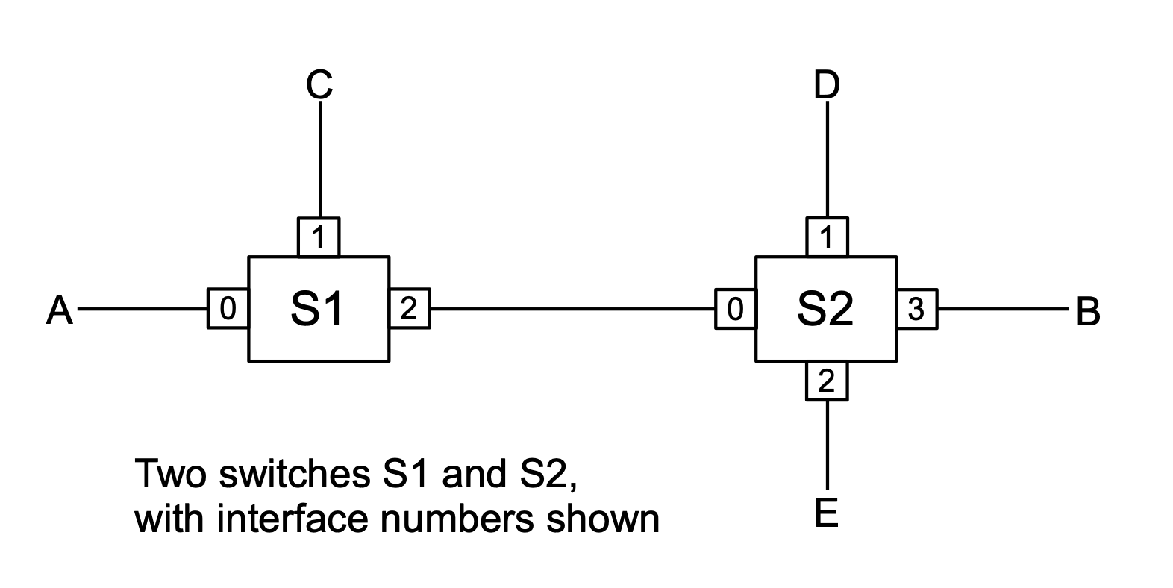
How Packets Get Where They Need to Go
Attached to the network are routers and/or switches and/or gateways with incoming links and outgoing links (a link is a wire)
The router will have a routing table to decide which outgoing link the packet should take to get closer to their destination
Source Peter L Dordal CC BY-NC-ND 3.0

Slide 10
Routing Tables for S1 and S2
S1
destination | Next hop
A | 0
C | 1
B | 2
D | 2
E | 2
S2
destination | Next hop
A,C | 0
D | 1
E | 2
B | 3
Source Peter L Dordal CC BY-NC-ND 3.0
How would a packet go from A to E?

Slide 11
Stateless
“To improve robustness of the communication system, gateways are designed to be stateless, forwarding each IP datagram independently of other datagrams. As a result, redundant paths can be exploited to provide robust service in spite of failures of intervening gateways and networks.” RFC 1122
State means data that you save, in a variable or file. The stateless idea is that the routers don’t have to remember anything about packets going by.
Robust means it doesn’t fail or crash.

Slide 12
Congestion
Wired or Wireless, it is a shared medium with many clients and servers
Congestion: hardware, such as a router can get overwhelmed by too much data
Algorithms needed to throttle down at times, maintain fairness for everyone, etc.

